Slide 1
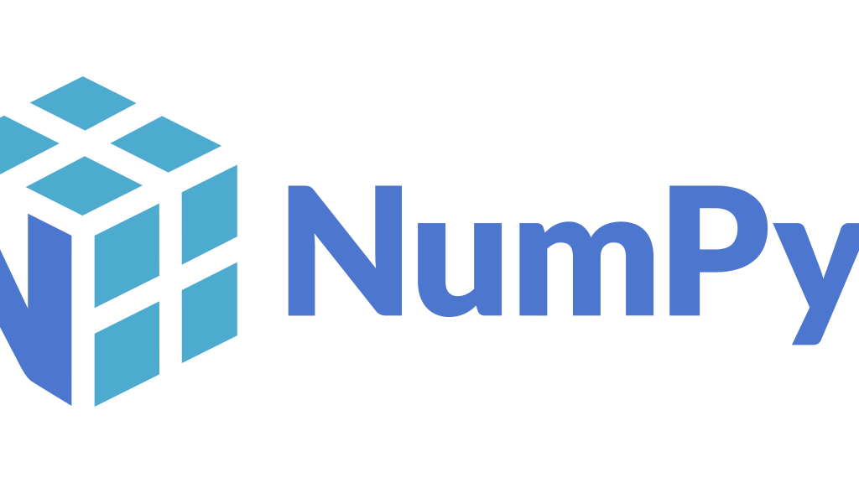
Numpy

Slide 2
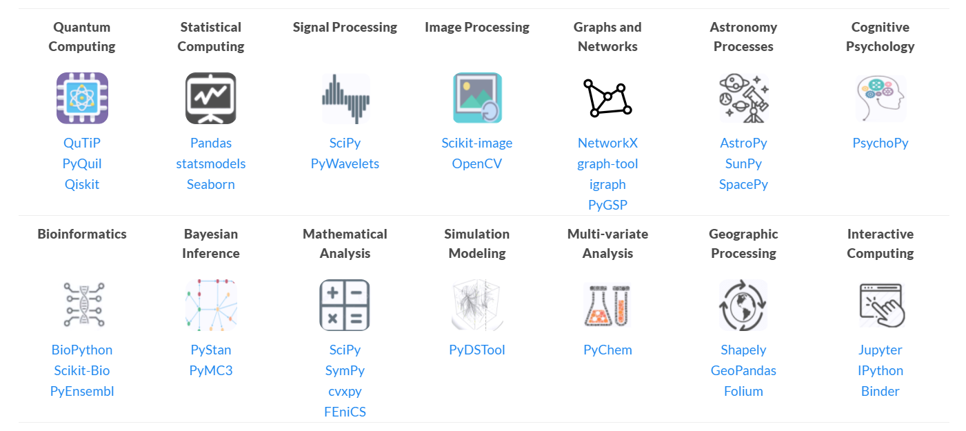
Scientific domains

Slide 3
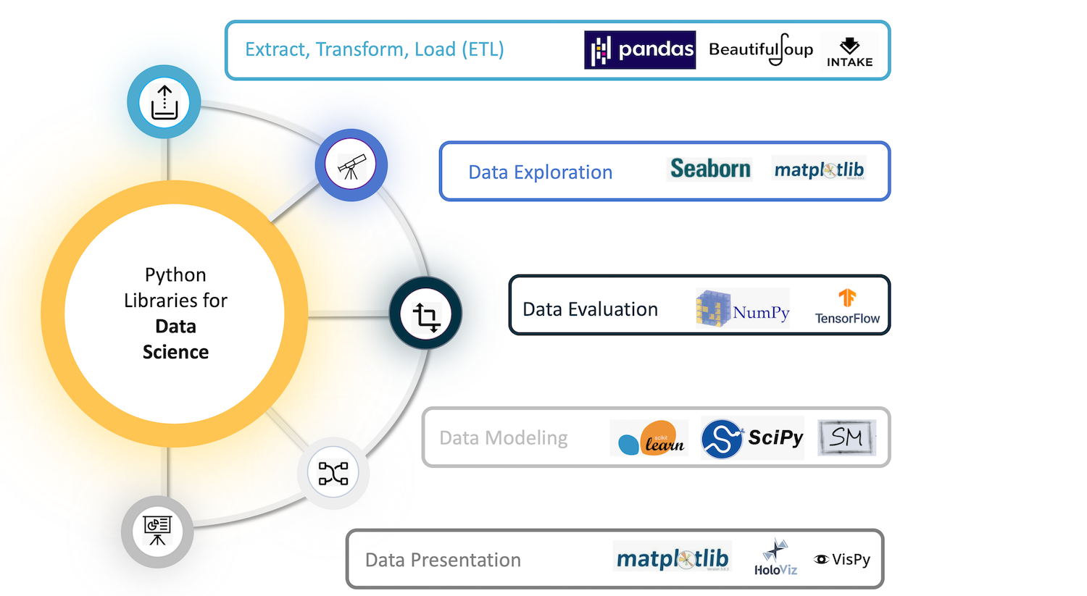
Data science
NumPy lies at the core of a rich ecosystem of data science libraries. A typical exploratory data science workflow might look like:
Extract, Transform, Load: Pandas, Intake, PyJanitor
Exploratory analysis: Jupyter, Seaborn, Matplotlib, Altair
Model and evaluate: scikit-learn, statsmodels, PyMC3, spaCy
Report in a dashboard: Dash, Panel, Voila

Slide 4
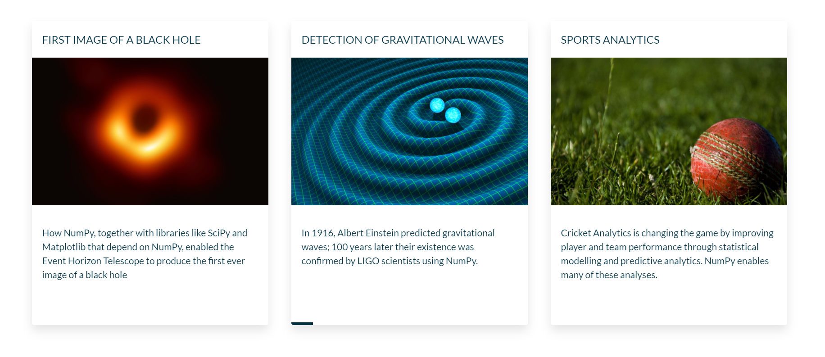
Case studies

Slide 5

FIRST IMAGE OF A BLACK HOLE

Slide 6
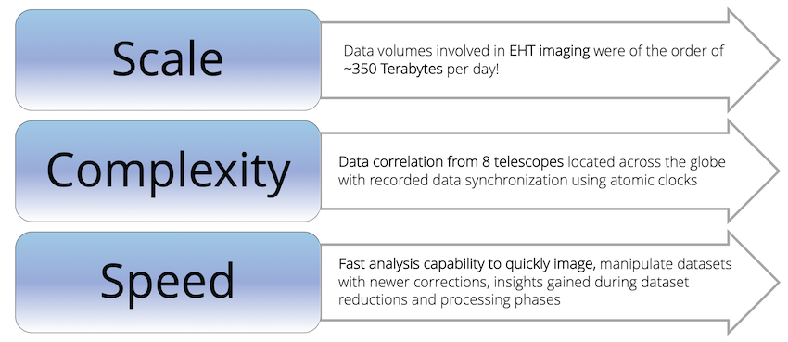
Event Horizon telescope (EHT) Challenges

Slide 7
Challenges
Computational scale
EHT poses massive data-processing challenges, including rapid atmospheric phase fluctuations, large recording bandwidth, and telescopes that are widely dissimilar and geographically dispersed.
Too much information
Each day EHT generates over 350 terabytes of observations, stored on helium-filled hard drives. Reducing the volume and complexity of this much data is enormously difficult.
Into the unknown
When the goal is to see something never before seen, how can scientists be confident the image is correct?

Slide 8
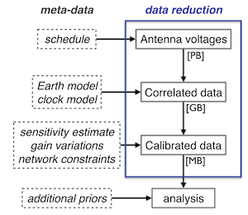
Data Processing Pipeline
(Diagram Credits: The Astrophysical Journal, Event Horizon Telescope Collaboration)

Slide 9
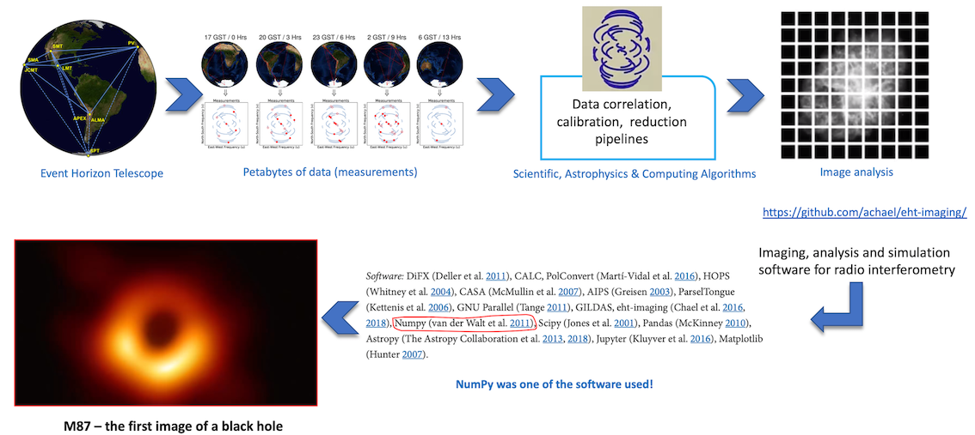
NumPy’s role in Black Hole imaging

Slide 10
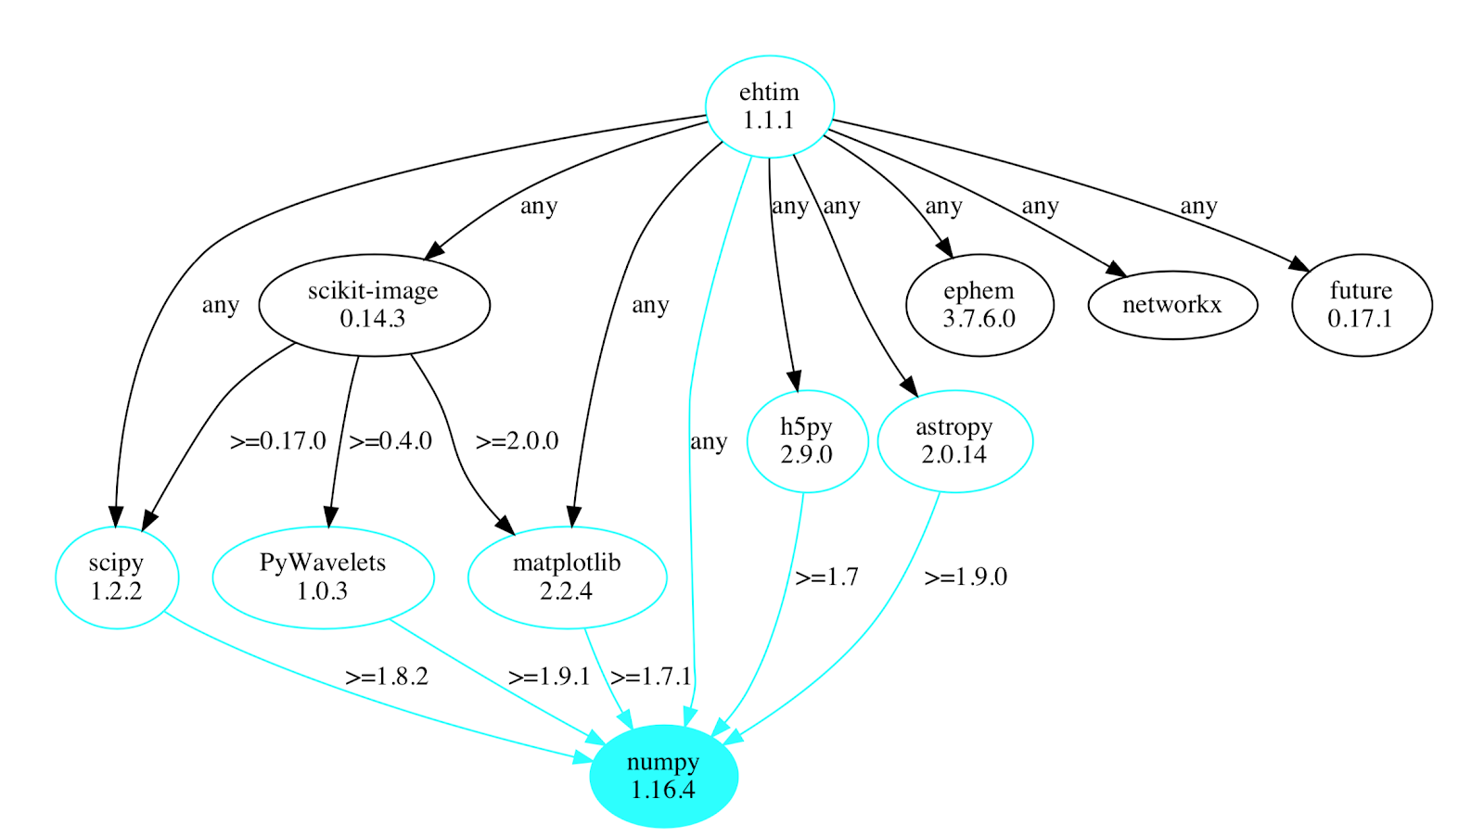
Software dependency chart of ehtim package highlighting NumPy
https://github.com/achael/eht-imaging

Slide 11
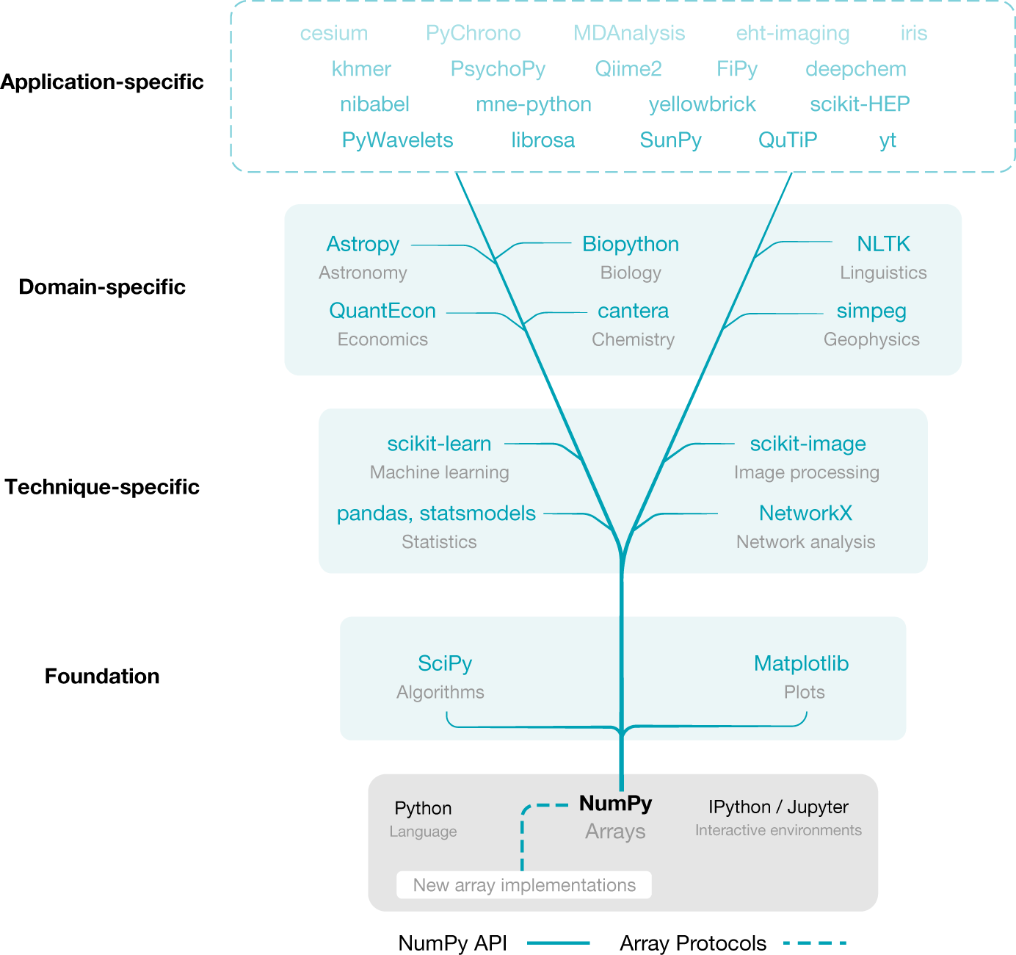
NumPy is the base of the scientific Python ecosystem

Slide 12
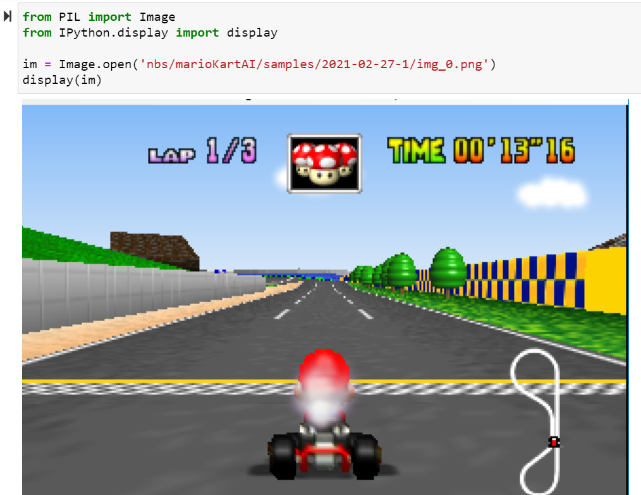
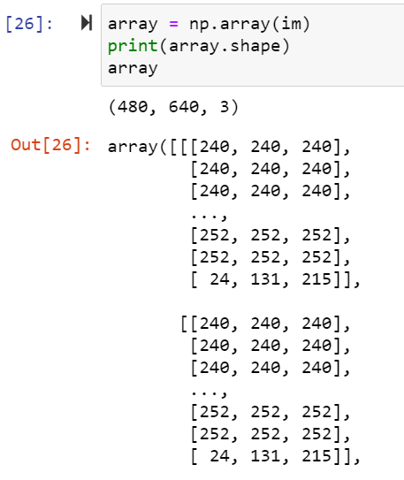
Images are 3D arrays (Red,Green,Blue)
Notes:
Import numpy as np
from PIL import Image
from IPython.display import display
im = Image.open('nbs/marioKartAI/samples/2021-02-27-1/img_0.png')
display(im)
array = np.array(im)
print(array.shape)
array

Slide 13
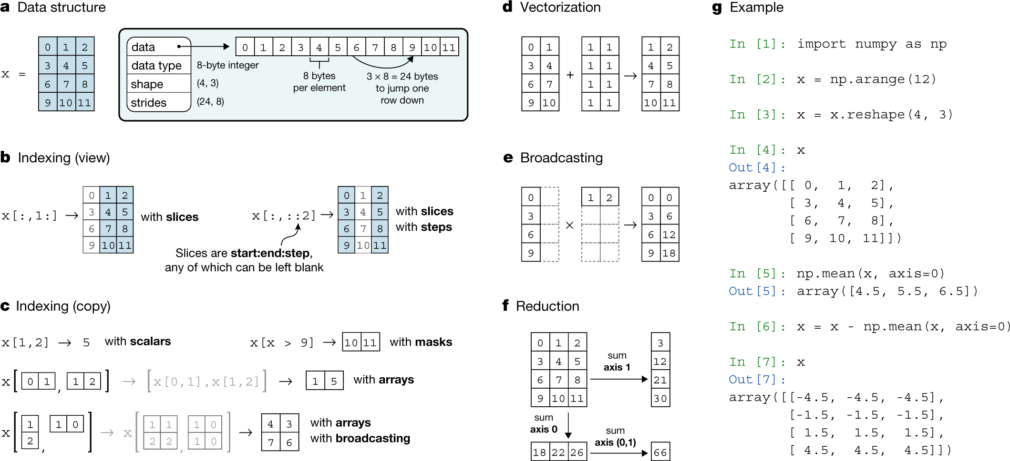
Array programming with NumPy

Slide 14
Agenda
Data structure
Indexing (view)
Indexing (copy)
Vectorization
Broadcasting
Reduction
Example

Slide 15
The NumPy array data structure and its associated metadata fields

Slide 16
Indexing an array with slices and steps
These operations return a ‘view’ of the original data.

Slide 17
Indexing an array with masks, scalar coordinates or other arrays
It returns a ‘copy’ of the original data.

Slide 18
Vectorization efficiently applies operations to groups of elements

Slide 19
Broadcasting in the multiplication of two-dimensional arrays

Slide 20
Reduction operations act along one or more axes
In this example, an array is summed along select axes to produce a vector, or along two axes consecutively to produce a scalar.

Slide 21
Example
import numpy as np
x = np.arange(12)
x = x.reshape(4,3)
np.mean(x,axis=0)
x = x - np.mean(x,axis=0)

Slide 22
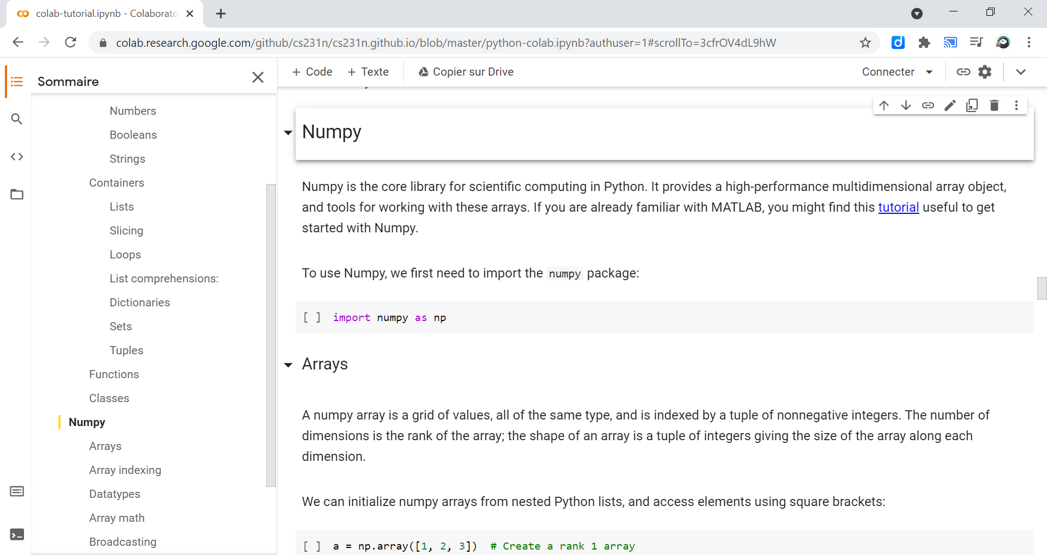

Slide 23
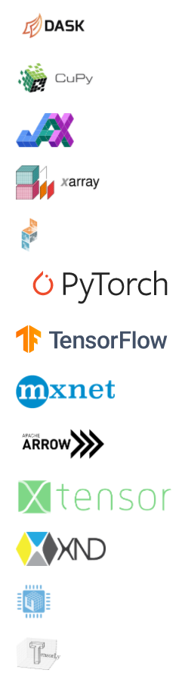
Array librairies
NumPy's API is the starting point when libraries are written to exploit innovative hardware, create specialized array types, or add capabilities beyond what NumPy provides.
Array Library | Capabilities & Application areas
Dask | Distributed arrays and advanced parallelism for analytics, enabling performance at scale.
CuPy | NumPy-compatible array library for GPU-accelerated computing with Python.
JAX | Composable transformations of NumPy programs: differentiate, vectorize, just-in-time compilation to GPU/TPU.
Xarray | Labeled, indexed multi-dimensional arrays for advanced analytics and visualization
Sparse | NumPy-compatible sparse array library that integrates with Dask and SciPy's sparse linear algebra.
PyTorch | Deep learning framework that accelerates the path from research prototyping to production deployment.
TensorFlow | An end-to-end platform for machine learning to easily build and deploy ML powered applications.
MXNet | Deep learning framework suited for flexible research prototyping and production.
Arrow | A cross-language development platform for columnar in-memory data and analytics.
xtensor | Multi-dimensional arrays with broadcasting and lazy computing for numerical analysis.
XND | Develop libraries for array computing, recreating NumPy's foundational concepts.
uarray | Python backend system that decouples API from implementation; unumpy provides a NumPy API.
TensorLy | Tensor learning, algebra and backends to seamlessly use NumPy, MXNet, PyTorch, TensorFlow or CuPy.

Slide 24
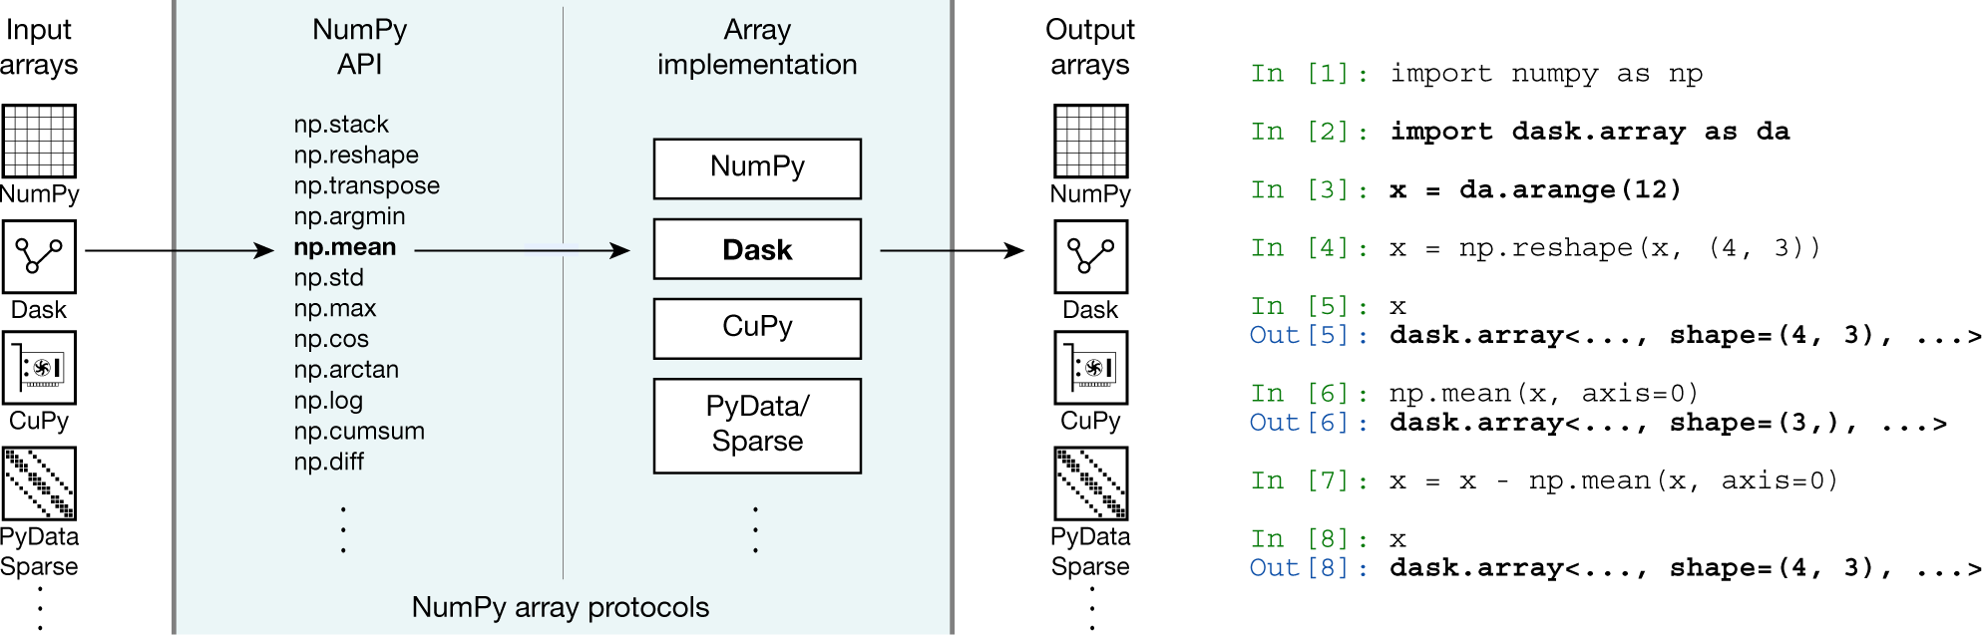
NumPy’s API and array protocols expose new arrays to the ecosystem
In this example, NumPy’s ‘mean’ function is called on a Dask array. The call succeeds by dispatching to the appropriate library implementation (in this case, Dask) and results in a new Dask array.

Slide 25
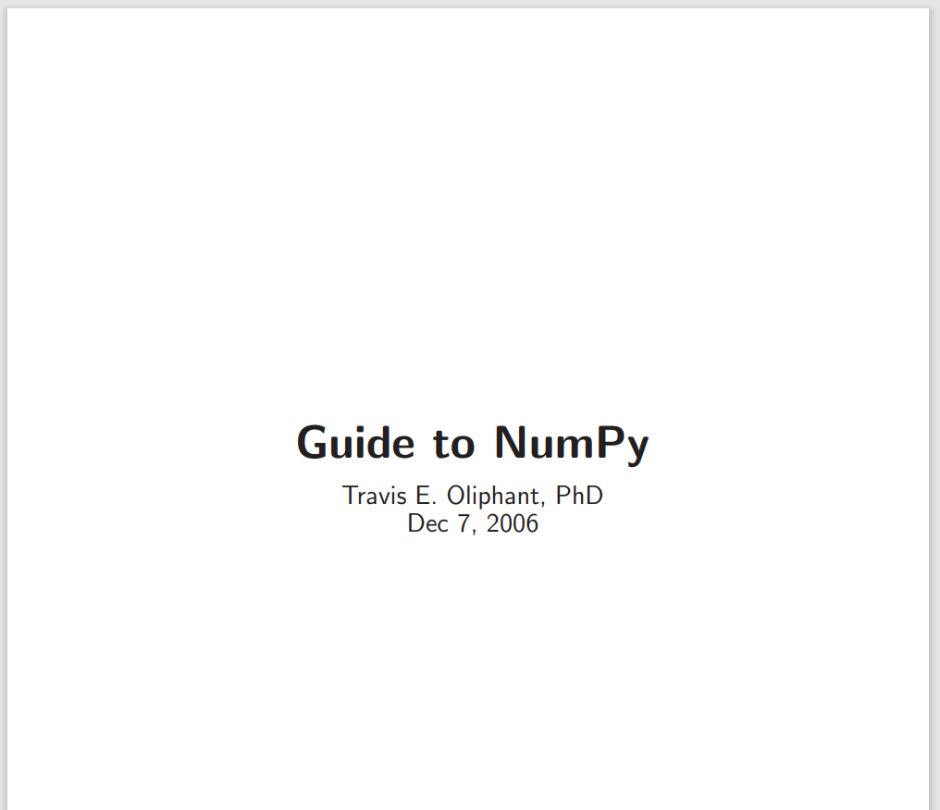
Numpy Resources
NumPy Quickstart Tutorial
NumPy tutorial by Nicolas Rougier
Stanford CS231 by Justin Johnson
Array programming with NumPy
numpybook.pdf (mit.edu) >>

